Slide 1
ACML101: Introduction to Chemistry
Inorganic Chemistry: Tutorial 1B

Slide 2
(1) (a) How will you distinguish between cis and trans isomers of [CrCl₂(NH₃)₄]Cl?
(b) How will you determine whether MA₂B₂ complex is square planner or tetrahedral by an experiment?
The cis isomer has two coordinated chloro groups as near neighbours. Hence it will react readily with oxalate ion giving tetraammine (oxalato) chromium (II) ion. The trans isomer will not react as readily as cis isomer. A bidentate oxalate dianion ligand can span only two adjacent positions as in the cis but not in the trans.
A square planar MA₂B₂ is capable of giving cis and trans isomers while a tetrahedral MA₂B₂ cannot do so.
(2) Propose an experiment to predict the structure of [MnBr₄]²⁻. What are the limitations of VBT theory in predicting the properties of the compound. (How crystal field theory is useful in predicting few properties of metal complexes will be explained in the class)
Since the coordination number of Mn²⁺ is four it will mainly have two possibilities Square planar (dsp² hybridization) or tetrahedral (sp³ hybridization). Unless magnetic moment is provided it will be difficult to predict its geometry. It shows magnetism 5.9 BM which indicate the sp³ hybridization.

Slide 3
3. Write down the d-orbital splitting diagram for [NiCl₄]²⁻ and [Ni(CN)₄]²⁻. Will these complexes be paramagnetic or diamagnetic?
d_{x2−y2}
Cyanide have strong ligand field. However, chloride is a weak ligand. Thus, [Ni(CN)₄]²⁻ will be square-planer as Δ will be higher in this geometry. However, [NiCl₄]²⁻ is tetrahedral because of the weak ligand field of chloride anion.
d_{xy}
Orbital energy
t₂
d_{z2}
e
d_{xz}, d_{yz}
Thus, [Ni(CN)₄]²⁻ is diamagnetic and [NiCl₄]²⁻ is paramagnetic.
Tetrahedral
[NiCl₄]²⁻
Square planar
[Ni(CN)₄]²⁻
4. Δ₀ values of [Ru(H₂O)₆]²⁺ and [RuCl₆]³⁻ are nearly same but according to spectrochemical series, the value for Δ₀ for the chlorine should be less compared to H₂O complex.
Oxidation state of the metal centre neutralize the ligand effect

Slide 4
(5) How many geometric isomers are possible for [Pd(NH₃)(NMe₃)ClBr]? [why it has square planar geometry not tetrahedral, it will be discussed in the class]
Ans:
(6) How do you expect (C₆H₅)₃P, (C₆H₅)₃PO and (C₆H₅)₂SO to behave as coordinating ligands?
(C₆H₅)₃P: Phosphorus is a group 15 element and it is trivalent in this compound, therefore it has a lone pair of electrons on phosphorus. It can function as a monodentate ligand.
C₆H₆)PO: However phosphorus has no lone pair but oxygen has lone pairs which may be used for donating to electron deficient species. Moreover the P-O bond is polar in nature. It is also mondentate ligand. Since the lone pairs are in the same atom, it has no scope to act as a bidentate ligand.
(C₆H₅)₂SO: Sulfur and oxygen both are group 16 elements. Therefore they have six electrons in their outer shell. Sulfur has one and oxygen has two lone pairs of electrons. Since the lone pairs are on different atoms the compound acts as an ambidentate ligand working either through sulfur or through oxygen. It prefers to bind Pt(II), Pd(II) through sulfur and Co(II), Ni(II), Mn(II), Zn(II) through oxygen.

Slide 5
7. Calculate the CFSE values for [NiCl₄]²⁻, [Mn(H₂O)₆]²⁺, [Co(NCS)₆]⁴⁻ and [Fe(CN)₆]⁴⁻. Explain why the CFSE for a low-spin d⁶ configuration contains a 2P term? ((previous year question)
d⁸
d⁵
d⁶
d⁷
e_{g}
e_{g}
t₂
e
Orbital energy
t_{2g}
[NiCl₄]²⁻
t_{2g}
t_{2g}
[Mn(H₂O)₆]²⁺
[Fe(CN)₆]⁴⁻
[Co(NCS)₆]⁴⁻
CFSE =
4 × (−0.6 Δ_{t}) + 4 × (0.4 Δ_{t})
= −0.8 Δ_{t}
CFSE =
3 × (−0.4 Δo) + 2 × (0.6 Δo)
= 0
CFSE =
6 × (−0.4 Δo) + 2P
= −2.4Δ_{O} + 2P
CFSE =
6 × (−0.4 Δ_{o}) + 1× (0.6 Δ_{O}) + P
= −1.8Δ_{O} + P
CFSE = −2.4Δ_{O} + 3P
CFSE = −1.8Δ_{O} + 2P

Slide 6
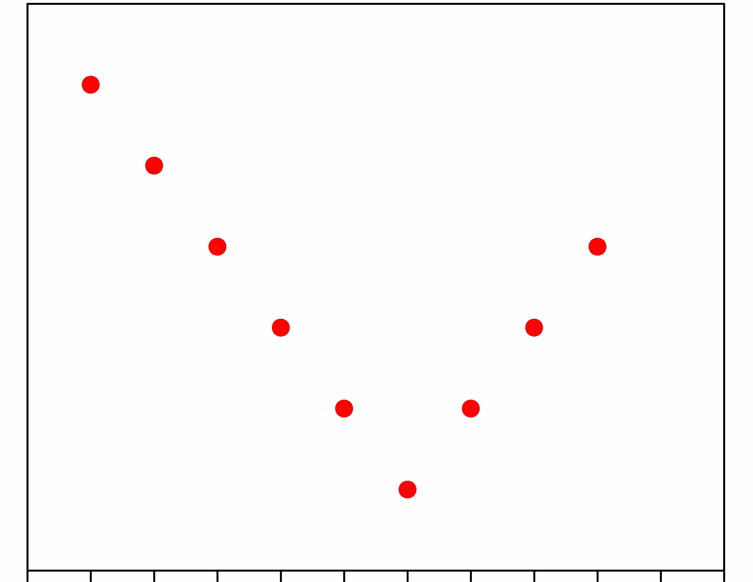
8. Sketch the ionic radii curve for the first series of transition metal ions in M²⁺ oxidation state. Consider an octahedral geometry and cyanides as ligand. What will be the lowest point if the metal has +3 oxidation state?
Ionic radii
d¹
d²
d³
d⁴
d⁵
d⁶
d⁷
d⁸
d⁹
Sc²⁺
Ti²⁺
V²⁺
Cr²⁺
Mn²⁺
Fe²⁺
Co²⁺
Ni²⁺
Cu²⁺
3d metal ions
2nd part: Co³⁺ = d⁶

Slide 7
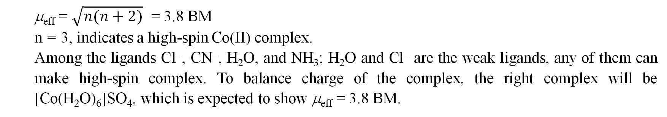
(9) The magnetic moment of [CoL₆]SO₄ is 3.8 BM. Choose correct ligands from water, cyanide, chloride and ammonia, and draw the crystal-field splitting diagram. (previous year questions)
μ_{eff} = $\sqrt{n(n+2)}$ = 3.8 BM
n = 3, indicates a high-spin Co(II) complex.
Among the ligands Cl⁻, CN⁻, H₂O, and NH₃; H₂O and Cl⁻ are the weak ligands, any of them can make high-spin complex. To balance charge of the complex, the right complex will be [Co(H₂O)₆]SO₄, which is expected to show μ_{eff} = 3.8 BM.

Slide 8
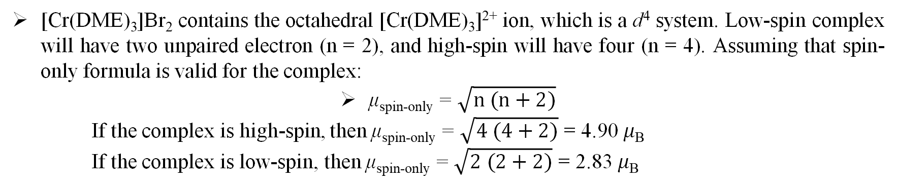
10. At room temperature, the observed value of 𝜇_{eff} for [Cr(CH₃OCH₂CH₂OCH₃)₃]Br₂ is 4.75 𝜇B. Is the complex high-spin or low spin?
[Cr(DME)₃]Br₂ contains the octahedral [Cr(DME)₃]²⁺ ion, which is a d⁴ system. Low-spin complex will have two unpaired electron (n = 2), and high-spin will have four (n = 4). Assuming that spin-only formula is valid for the complex:
μ_{spin-only} = $\sqrt{n (n+2)}$
If the complex is high-spin, then μ_{spin-only} = $\sqrt{4 (4+2)}$ = 4.90 𝜇_{B}
If the complex is low-spin, then μ_{spin-only} = $\sqrt{2 (2+2)}$ = 2.83 𝜇_{B}
Therefore, the complex is high-spin.
11. An aqueous solution of Co(III) sulphate is diamagnetic but becomes paramagnetic when a large excess of fluoride is added. Explain.
Co(III) sulfate in water is present as [Co(H₂O)₆]³⁺. Addition of excess fluoride ion in solution results in the formation of [CoF₆]³⁻, which is high-spin. Thus, the later complex is paramagnetic.

Slide 9
12. Solutions of [Cr(OH₂)₆]³⁺ ions are pale blue green but the chromate ion, CrO₄^{2–}, is an intense yellow. Characterize the origins of the transitions and explain the relative intensities.
Green color of the solution of [Cr(OH₂)₆]³⁺ (t_{2g}³e_{g}⁰) appears because of spin-allowed and Laporte forbidden d−d transition. The color intensity of the solution is weak.
CrO₄²⁻ (d⁰) shows intense yellow color because of oxygen-to-chromium(VI) charge-transfer transitions. Such transitions are Laporte ad spin-allowed, thus very intense and exhibits very high molar extinction coefficient values.

Slide 10
(13) The value of 𝝐_{max} in the electronic spectra of [CuCl₄]²⁻ and [Cu(OH₂)₆]²⁺ differ by a factor of about 100. Comment on this observation and state which complex you expect to exhibit the larger value of 𝝐_{max}. (previous year question)
Both the complex contain Cu²⁺ ion and it is d⁹ system.
[CuCl₄]²⁻ results spin-allowed and Laporte allowed d−d transitions.
[Cu(OH₂)₆]²⁺ results spin-allowed and Laporte forbidden d−d transitions.
Unlike the octahedral case, in a tetrahedral complex the metal p orbitals have the same symmetry (t₂) as do the metal d_{xy}, d_{yz}, and d_{zx} orbitals. Because they are of the same symmetry, the t₂ set of d orbitals will be mixed by the crystal field with the metal p orbitals. This in turn means that an e→t₂ transition contains some d−p component and this component is an allowed transition. Evidently, the intensity of the e→t₂ transition is related to the extent of mixing and the extent of mixing assessed, at least qualitatively, from the intensities of bands in the spectra.
Therefore, 𝝐_{max} value for [CuCl₄]²⁻ is much higher compared to [Cu(OH₂)₆]²⁺.

Slide 11
14. Arrange the following species in the order of increasing Jahn Teller distortion in an octahedral environment high-spin cobalt (III) and low-spin Co(II)
Electron arrangements are (a) high spin Co(III) t_{2g}⁴e_{g}² (b) low-spin Co(II) t_{2g}⁶e_{g}¹
Jahn Teller distortion is more significant when the e_{g} level is unsymmetrically occupied than when the t_{2g} level is unsymmetrically occupied.
So the increasing order of Jahn Teller distortion is High spin Co(III)<low-spin Co(II)
15. Which complex is more stable cis[Cu(en)₂2H₂O]²⁺ or trans[Cu(en)₂2H₂O]²⁺
Due to Jahn Teller distortion Trans is more stable

